Slide 1
Corporate overview
Bring light anywhere.

Slide 2
Who is G&G?
Target Markets
Featured Project
Product Portfolio
Questions?
Corporate overview: bring light anywhere.

Slide 3
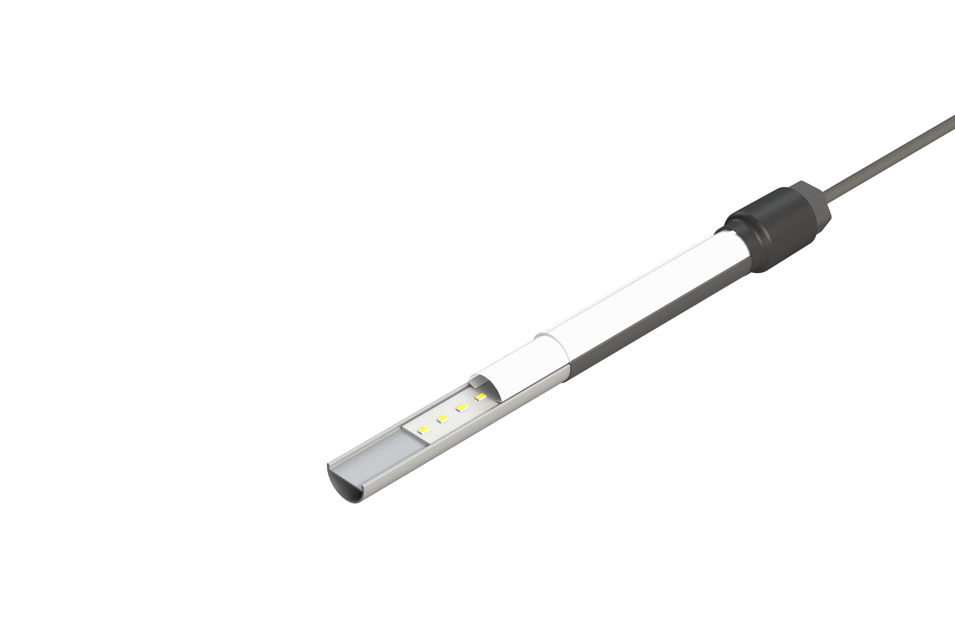
What we do
From one facility in Clifton Park, New York, we design, engineer, manufacture, and provide full-service support for harsh environment LED lighting solutions that are made to be…
STRONG.
Tested to the extremes.
SIMPLE.
Easy to install and maintain.
COMPACT.
Low-profile housing.
Corporate overview: bring light anywhere.

Slide 4
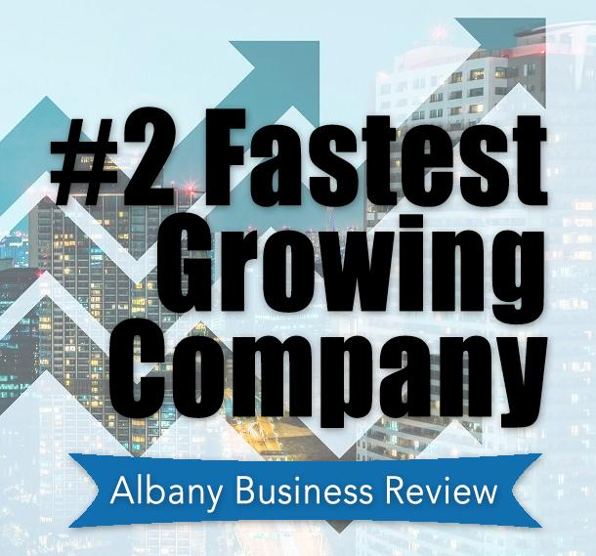
Who we are
Your LED Lighting Solution For Harsh Environments
American made solutions for challenging industrial lighting applications
Recognized as Inc. 5000 Fastest Growing Company for seven consecutive years
Named as the 2nd Fastest Growing Company in New York’s Capital Region 2020
Corporate overview: bring light anywhere.

Slide 5
Meet the g-squad
Everything at G&G revolves around our three P’s:
Our PURPOSE to solve challenging industrial LED lighting problems
Our PASSION to exceed the expectations of our customers, reps and employees
Our PEOPLE that make it all possible
Our company was founded on the premise of ‘people helping people’ and that same basic principle continues to be threaded throughout the everyday interactions of our team.
Corporate overview: bring light anywhere.

Slide 6
Our core values
Positive Attitude
Detail oriented
Always learning
Does the right thing
Gets it
done
At G&G, we live and breathe our core values, upholding these standards in everything we do.
Corporate overview: bring light anywhere.

Slide 7
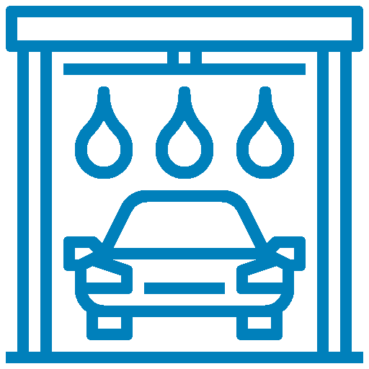
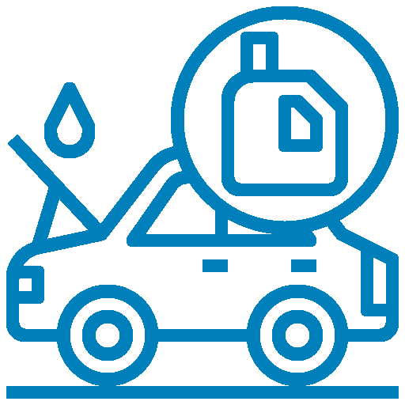
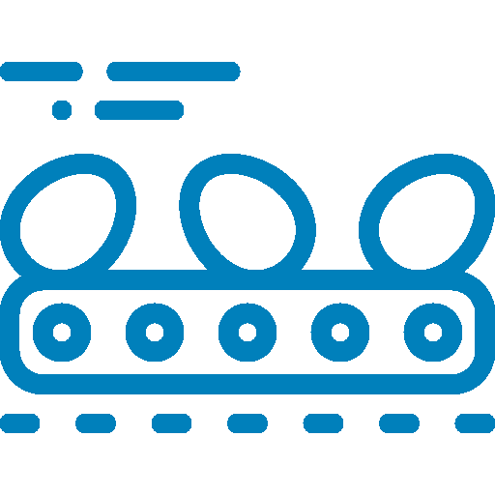
Target markets
Car Wash |  | Automotive Services |  | Transit |  | Industrial
Operators, chains and OEMs |  | Lube chains and maintenance pits |  | Agencies and engineering firms |  | Harsh environments and hazardous locations
Food Processing |  | Agriculture |  | Infrastructure |  | Architectural
Facilities, national chains and engineering firms |  | Barns, dairy parlors, pullet / laying barns and silos |  | Airports, tunnels, bridges, boardwalks, garages, etc. |  | Awning/canopy, façade, signage and perimeter
Corporate overview: bring light anywhere.

Slide 8
Featured project
WATCH VIDEO
WPX-RGB Color Mixing Harsh Environment LED Luminaire on Acosta Bridge, Jacksonville, FL
Corporate overview: bring light anywhere.

Slide 9
Product portfolio
Our highly engineered LED lighting solutions we’re made to last where others have failed. Our product line of industrial LED lighting is waterproof, corrosion-resistant, impact-resistant, compact and Buy American Act compliant:
WPX: Harsh Environment
GPX: General Purpose Driverless
FPX: Food Processing
VPX: Vaporsealed
HLX: Hazardous Location
TRX: Industrial Driverless
Corporate overview: bring light anywhere.

Slide 10
Low-Profile Linkable IP68/IP69K LED Linear Luminaire for Harsh Environments
Extreme protection from water and debris
Best-in-class chemical and corrosion resistance
High output, high efficiency design—up to 16,000 lumens / 2,000 lumens per foot at up to 160 LPW
Linkable design using quick-connect cabling for easier and faster installation
Run length up to 80’ of luminaires on a single power supply
Corporate overview: bring light anywhere.

Slide 11
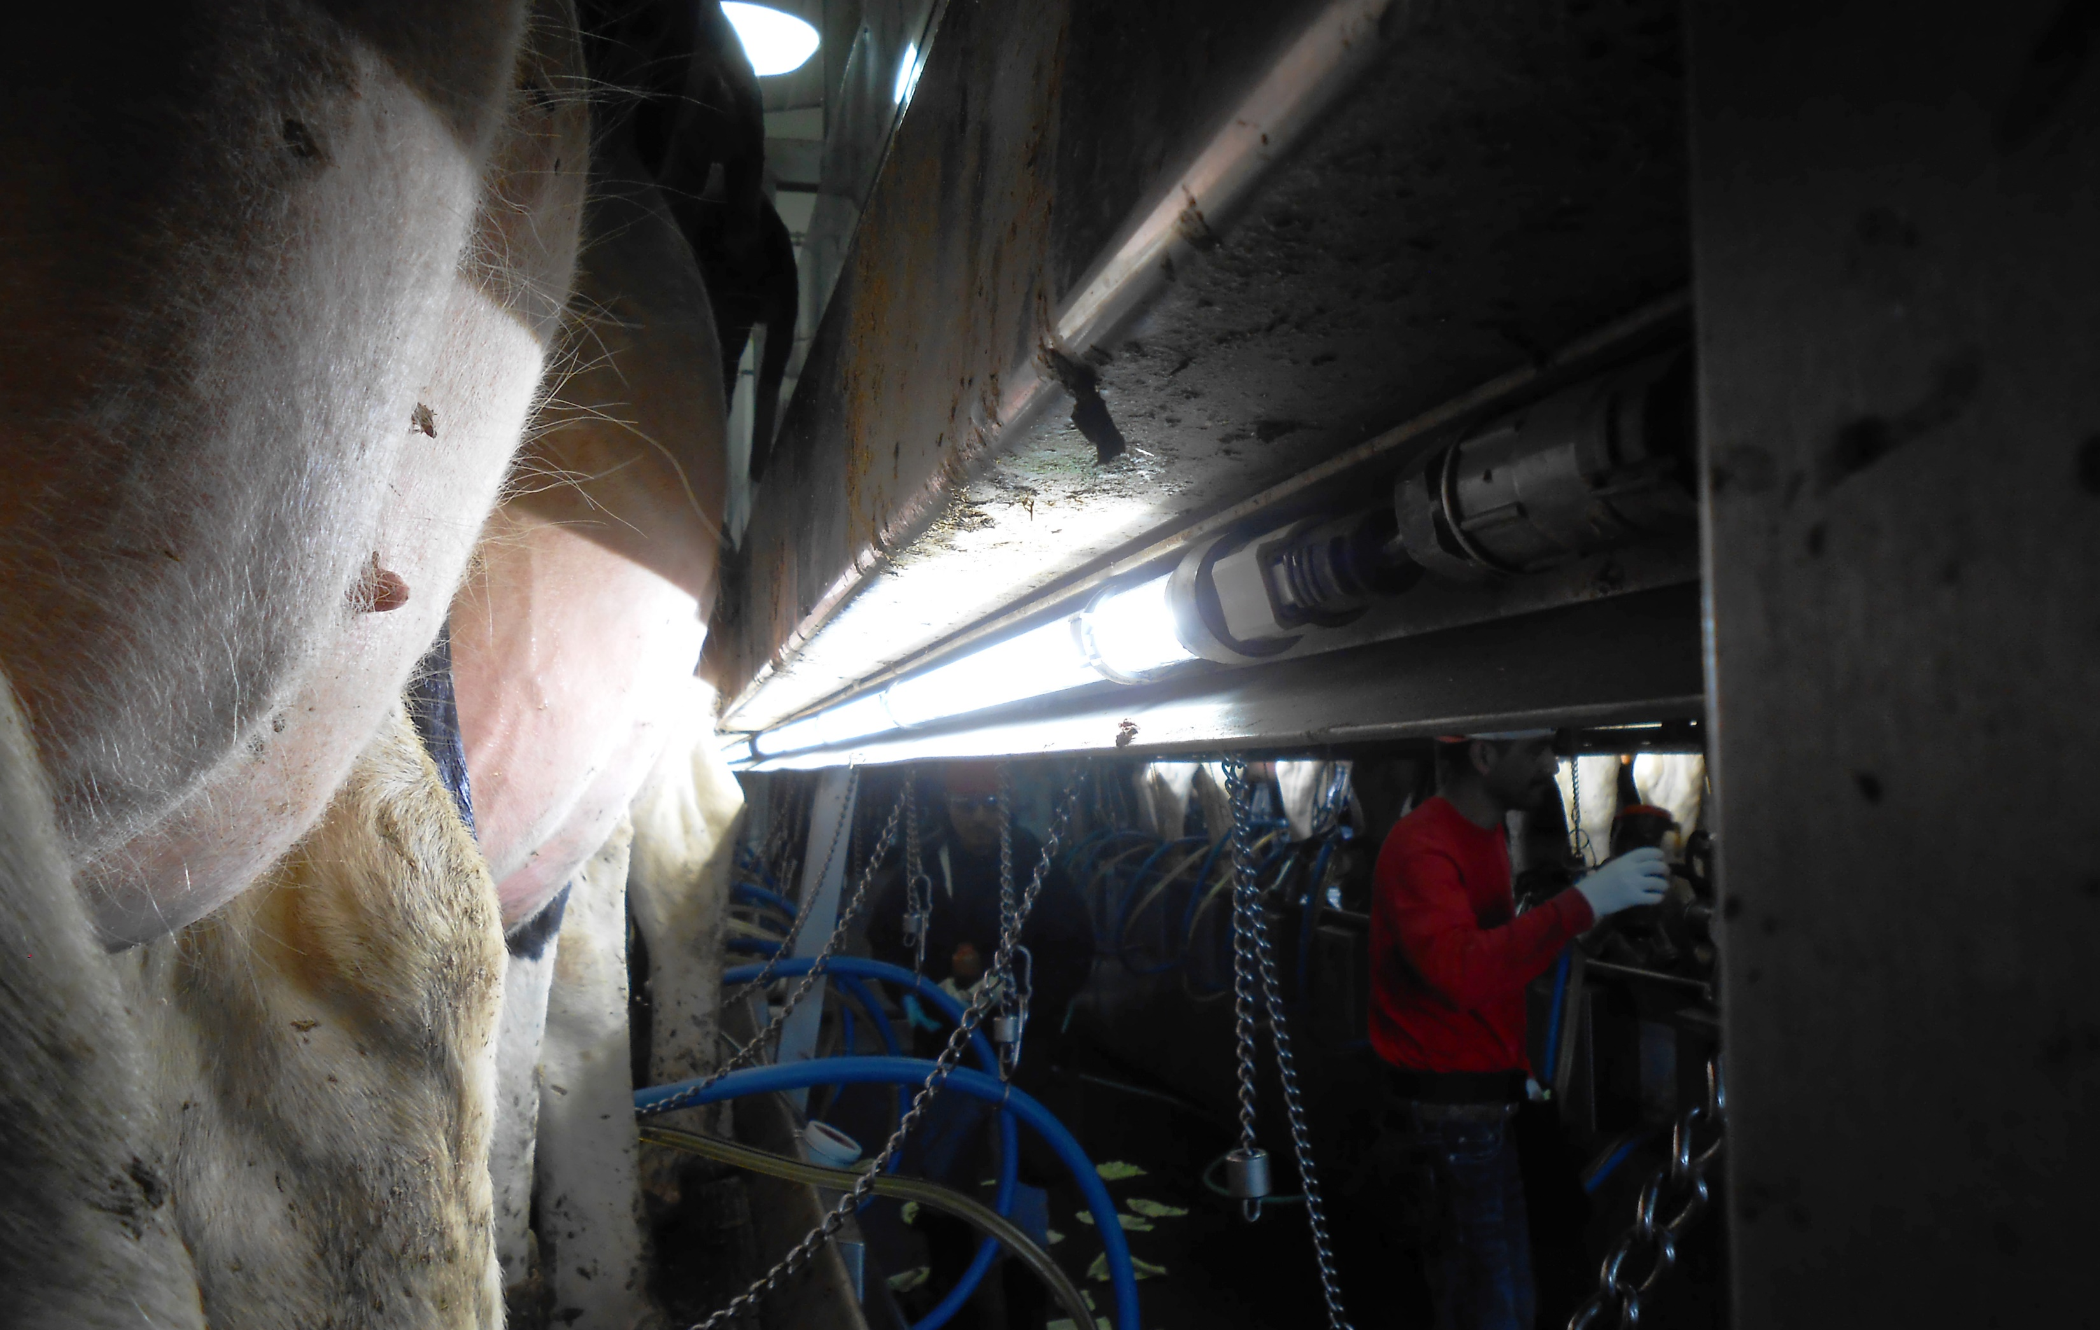
Wpx: harsh environment linear
Applications
Car Wash & Detail
Dairy – Poultry – Swine
Agriculture
Marine
Food Processing
Machine Lighting
Conveyor Lighting
Cold Storage
Service & Maintenance Areas
Certifications
Corporate overview: bring light anywhere.

Slide 12
Low-Profile, Driverless Linkable IP67 LED Linear Luminaire
Linkable luminaires that can be easily connected in long runs using convenient push-and-click connectors
Maintenance free driverless design for extreme reliability and lifetime
1” low-profile design for installations where space constraints are challenging
Seamless, permanently sealed housing provides IP67 ingress protection
Available in SO (600 lm/ft) and HO (1,000 lm/ft)
Corporate overview: bring light anywhere.

Slide 13
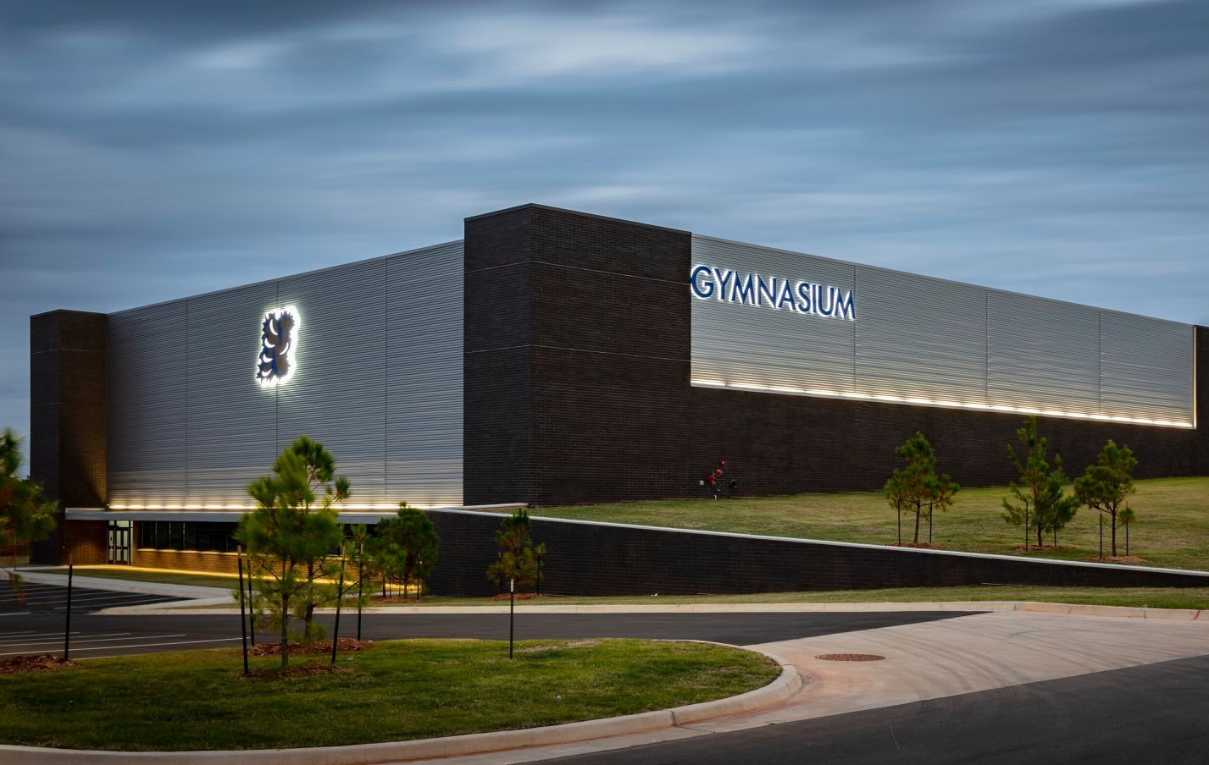
gpx: general purpose driverless linear
Applications
Awning
Façade
Canopy
Pedestrian Walkways
Signage
Coolers
Car Wash & Detail
Garages
Barns
Certifications
Corporate overview: bring light anywhere.

Slide 14
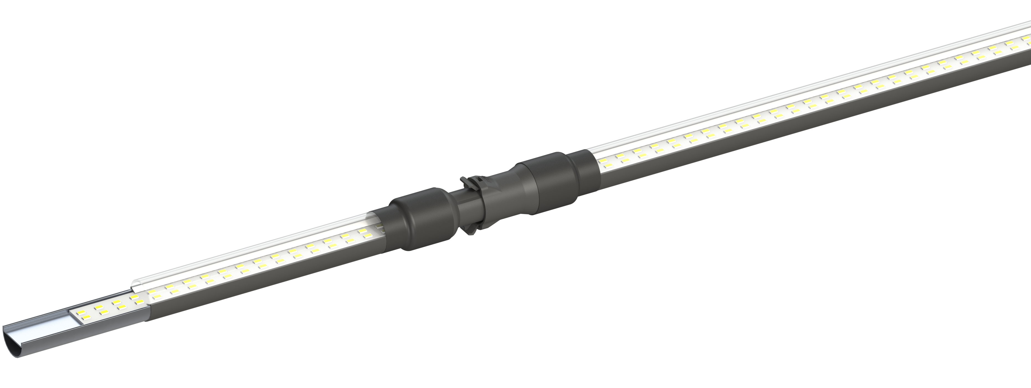
gpx product design
Push-and-Click Connectivity
Secure IP67 connectors allow rapid and convenient installation, connecting either end-to-end or using jumper cables.
Embedded Aluminum Heatsink
Provides maximum cooling for quality,
consistency and long lifetimes.
Permanently Sealed, Seamless
Co-polyester Exterior
IP67 ingress protection and extreme chemical resistance. Single piece enclosure requires no assembly and protects against intrusion of moisture, dust and other combustibles.
Maintenance Free Driverless Design
Connects directly to AC line voltage without an LED driver for maximum reliability
Corporate overview: bring light anywhere.

Slide 15
Linear Wash Down LED Luminaire for Task Lighting in Food Processing
Seamless, chemical-resistant IP69K housing
Lightweight, compact design for one-person installation
Superior illumination levels up to 20,000 lumens (290 fc at 3’ using standard output, 90 CRI)
Market leading efficiency at 130 LPW
Best in class lifetime – L70 > 100,000 hours
Ideal for hose down and quality inspection stations
Corporate overview: bring light anywhere.

Slide 16
Fpx: Food processing linear
Applications
Task Lighting
Inspection Stations
Area Light
Slaughter – Processing
Washdown Areas
Certifications
Corporate overview: bring light anywhere.

Slide 17
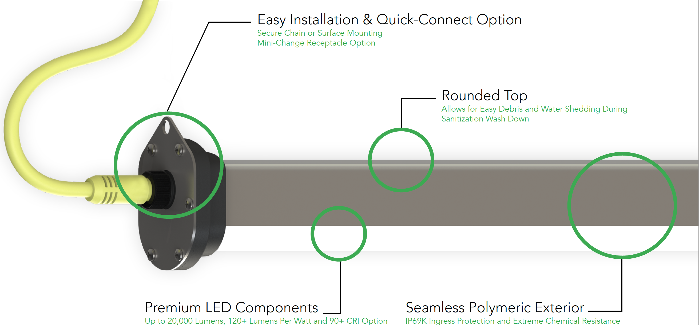
Fpx product design
Corporate overview: bring light anywhere.

Slide 18
Low-Profile, Driverless Vaporsealed LED Linear Luminaire
Seamless, permanently sealed housing provides IP68 ingress protection
Maintenance free driverless design for extreme reliability and lifetime
1” low-profile design for installations where space constraints are challenging
No seals, gaskets or clips eliminates possibility of debris and water accumulations
Corporate overview: bring light anywhere.

Slide 19
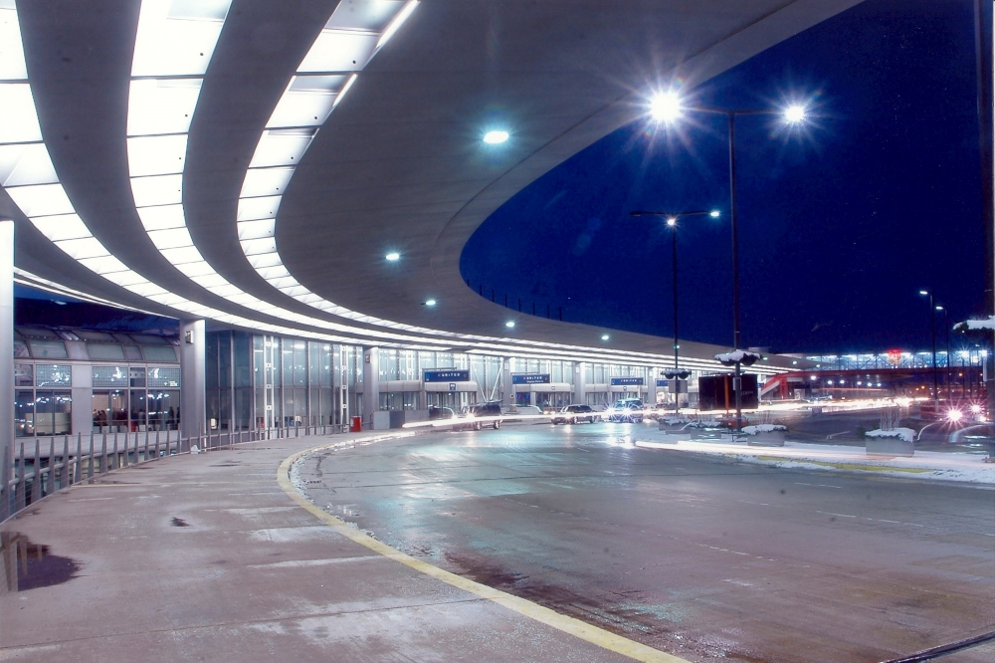
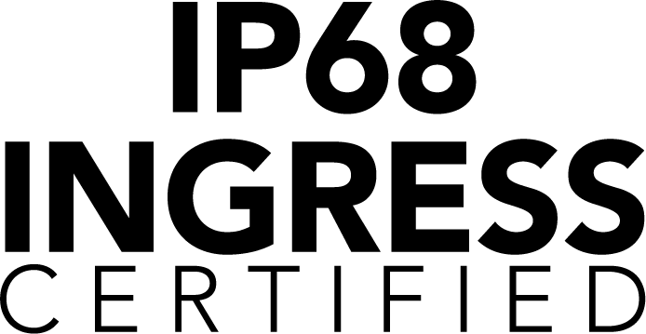
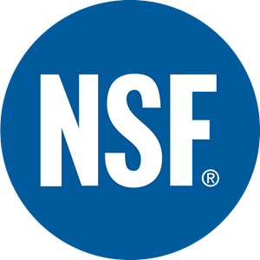
vpx: Vaporsealed linear
Applications
Manufacturing
Industrial Facilities
Food Processing
Agriculture
Marine
Service & Maintenance
Exterior Canopies
Parking Garages
Cold Storage
Certifications
Corporate overview: bring light anywhere.

Slide 20
vs.
NO DUST.
IP68 Ingress Certified. Debris Free.
NO RUST.
Waterproof, Chemical and UV Resistant.
NO FUSS.
No Clips, Gaskets or Drivers.
Assembly & Maintenance Free.
Corporate overview: bring light anywhere.

Slide 21
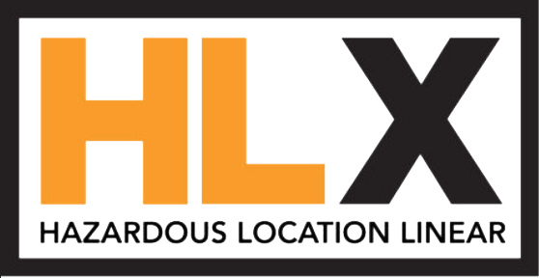
Low-Profile Linkable IP68/IP69K LED Linear for Hazardous Locations
Certified for hazardous locations Class 1: Division 2 and Class 2: Division 2
Linkable design using heavy duty quick-connect cabling for easier and faster installation
Maintenance free driverless design for extreme reliability and lifetime
Protection from water and debris in extremely harsh environments
Chemical and corrosion resistance
Ideal for mines, maintenance pits, grain silos, chemical & petroleum
Corporate overview: bring light anywhere.

Slide 22
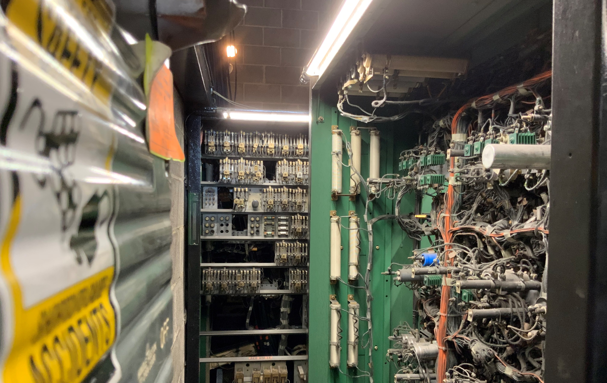
HLx: HAZARDOUS LOCATION linear
Applications
Petroleum
Refineries
Chemical Manufacturing
Loading Facilities
Waste Treatment and Disposal
Mills and Silos
Unventilated Maintenance Pits
Certifications
Corporate overview: bring light anywhere.

Slide 23
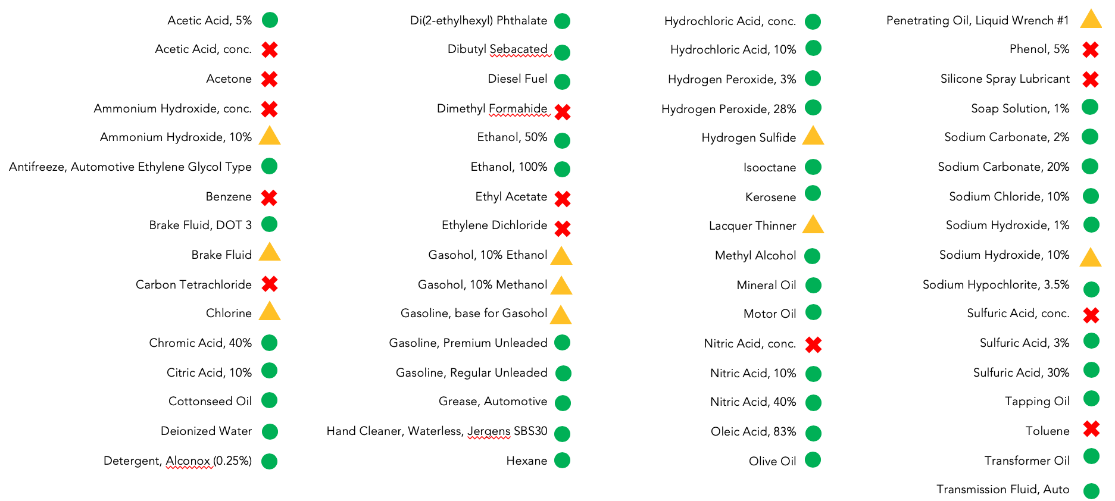
G&G chemical resistance
Corporate overview: bring light anywhere.

Slide 24
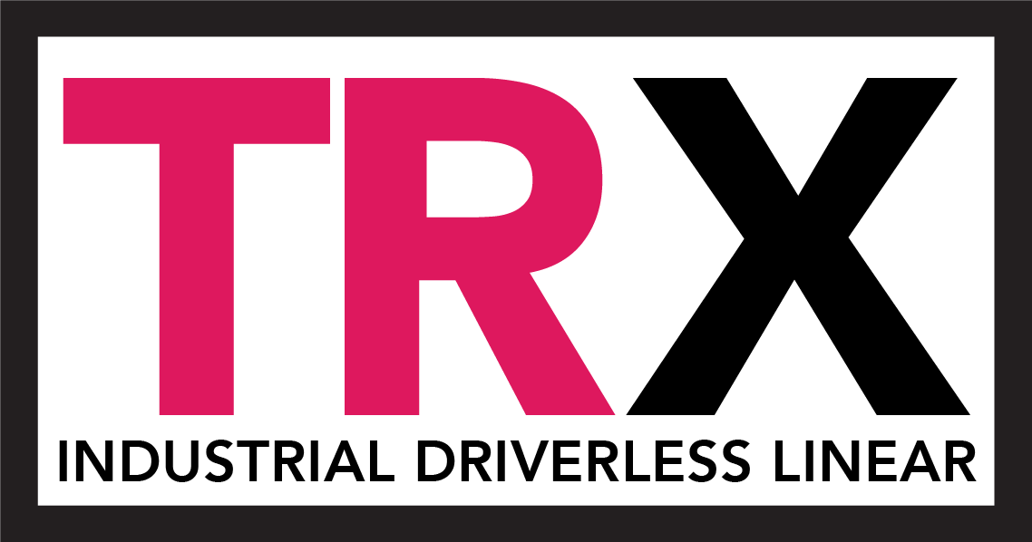
Low-Profile, Driverless AC LED Luminaire for Maintenance Pits
Low-profile aimable design
Seamless, permanently sealed housing provides
IP68 ingress protection in harsh environments
Maintenance free driverless design for extreme reliability and lifetime
Linkable design using heavy duty quick-connect cabling for easier and faster installation
Corporate overview: bring light anywhere.

Slide 25
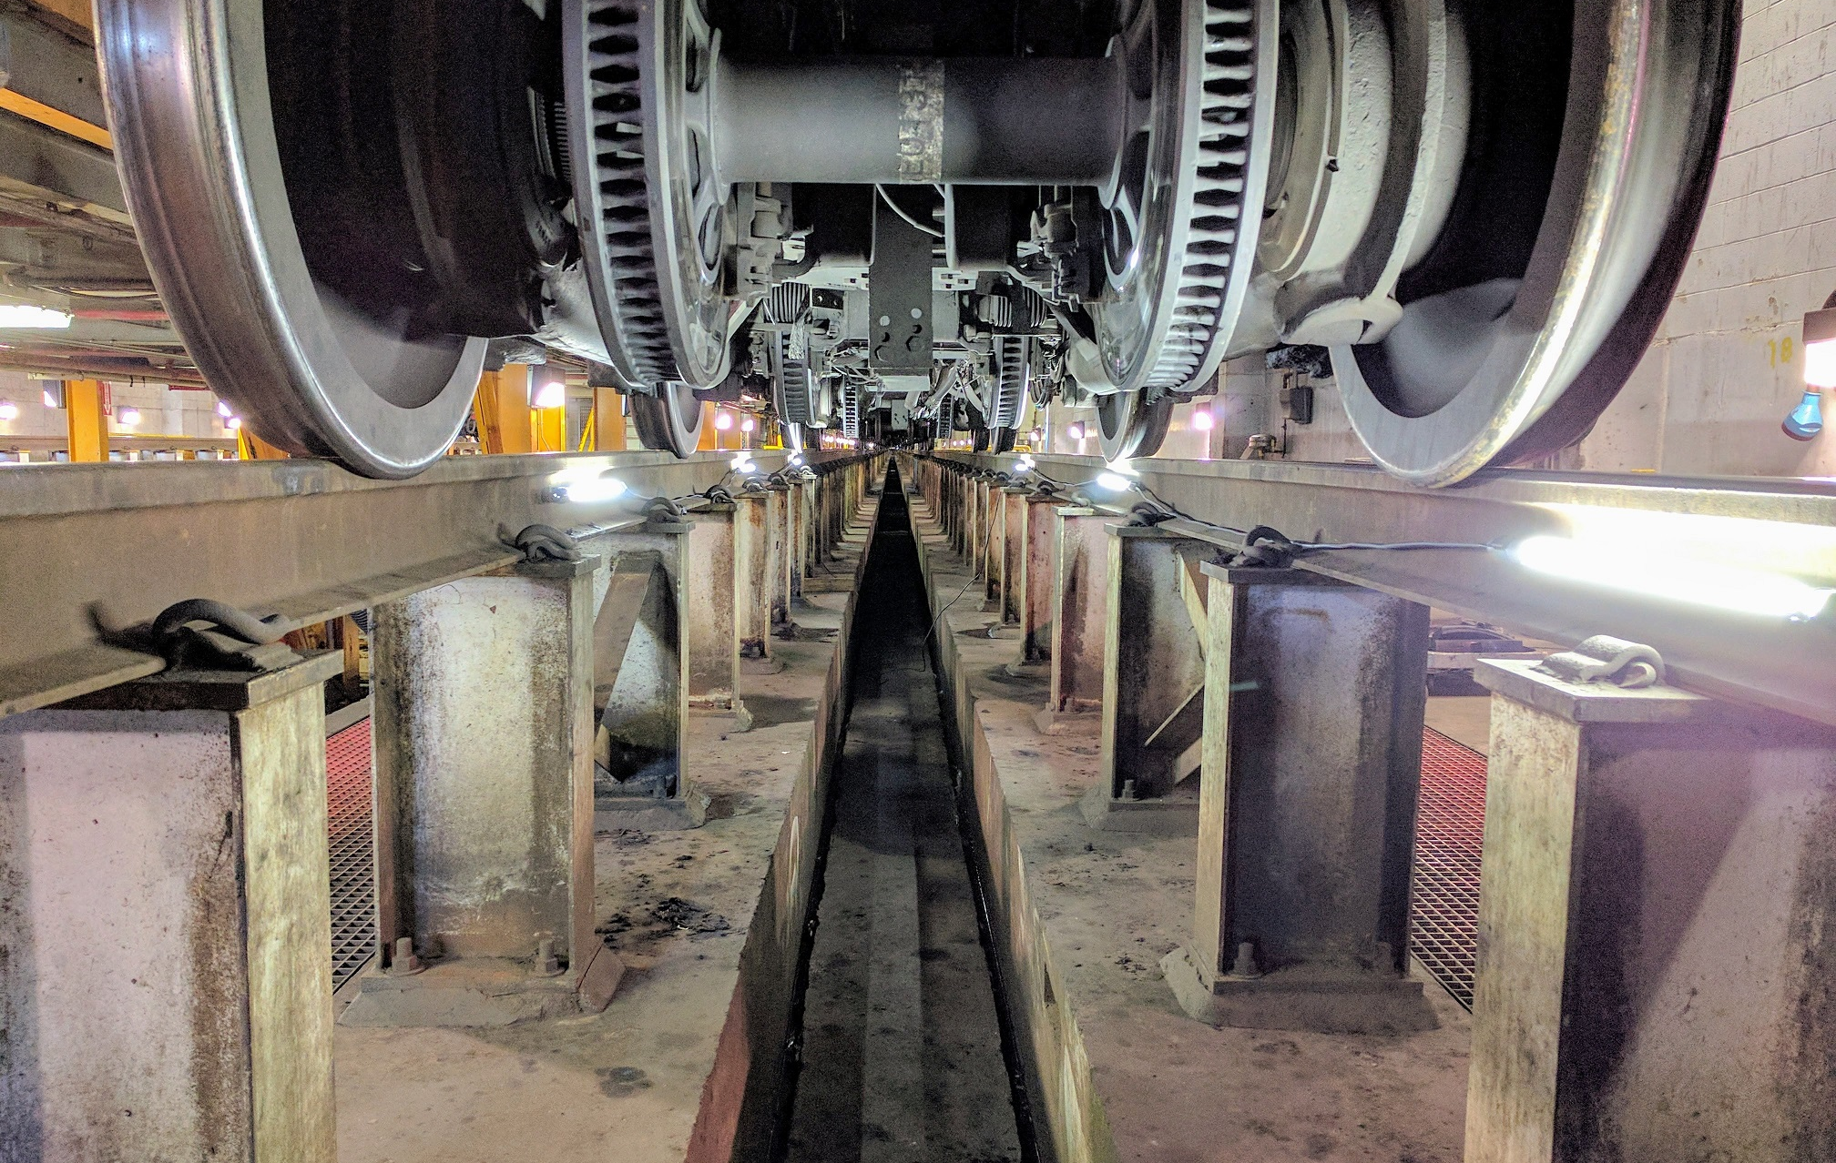
TRx: Industrial driverless linear
Applications
Train Stations
Subway Stations
Automotive services
Certifications
Corporate overview: bring light anywhere.

Slide 26
Questions?
Corporate overview: bring light anywhere.

